Slide 1
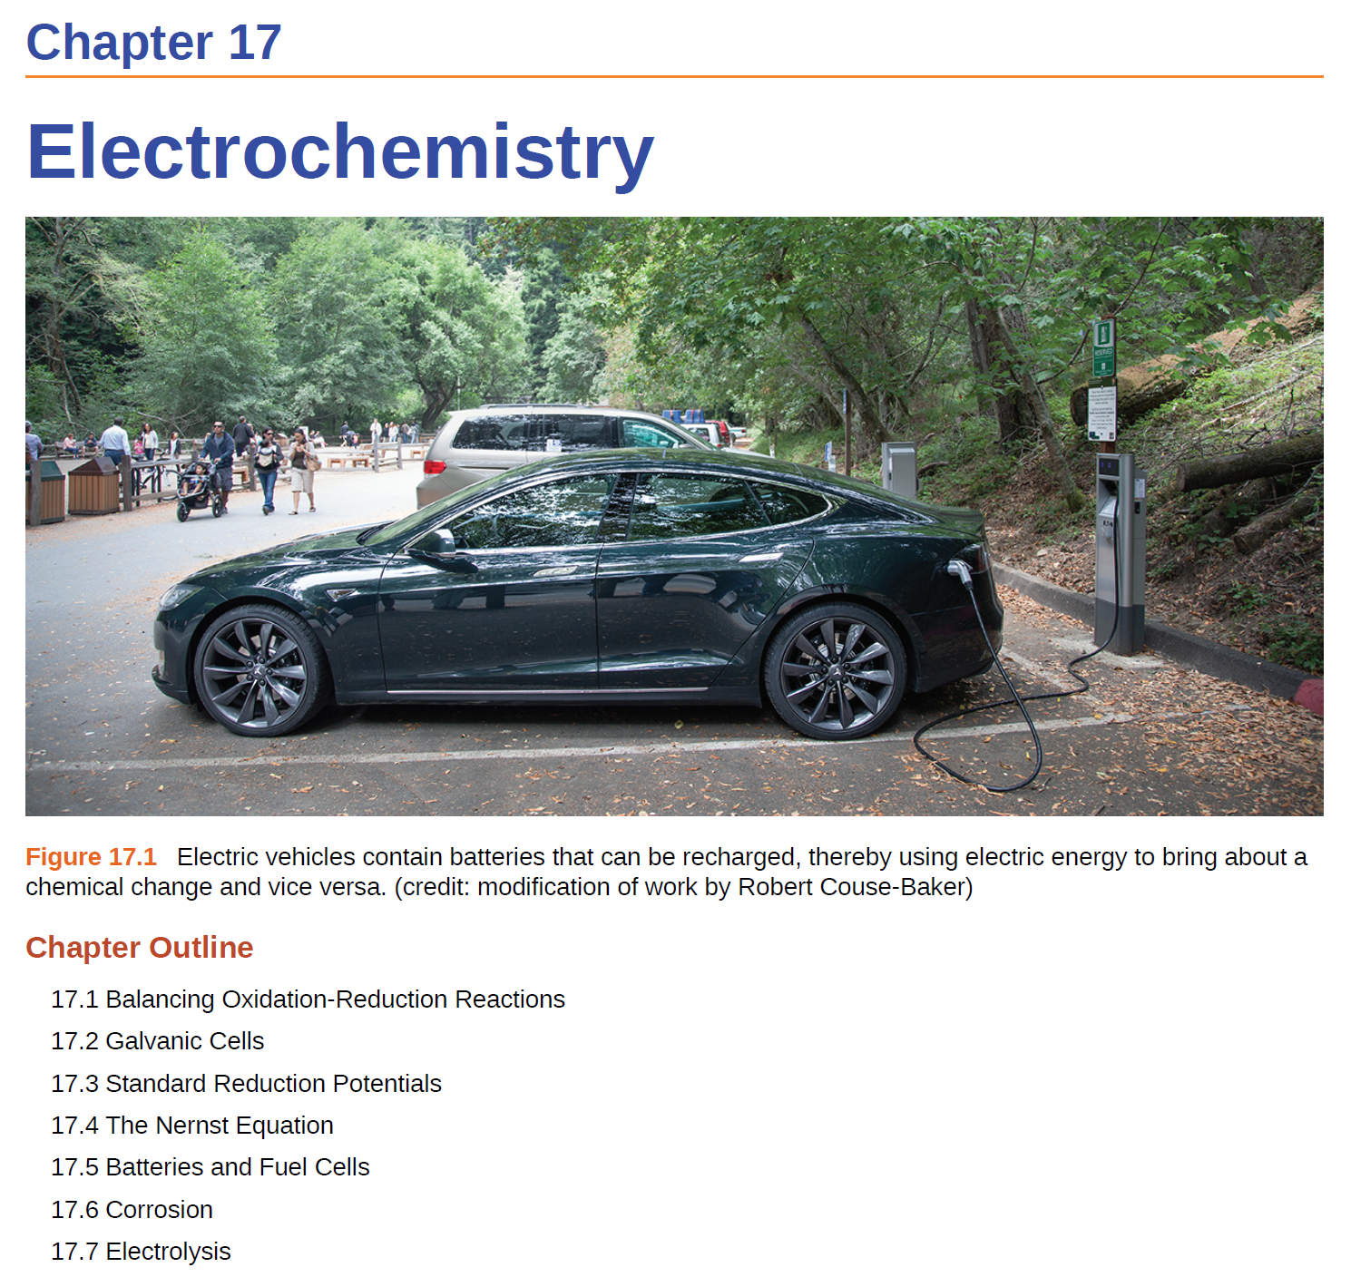

Slide 2
Electrochemistry Terminology
Electrochemistry is the study of the interconversion of electrical and chemical energy.
Electricity is the presence and flow of electrical charge (electrons or ions).
Current is the rate of flow of charge (SI unit: ampere, A).
Potential is the ability of the electric field to do work on the charge (SI unit: Volt, V).
Electric Circuit- the path of the flow of current. The flow is generated by a potential difference between two points.
REDOX- chemical oxidation and reduction reactions.

Slide 3
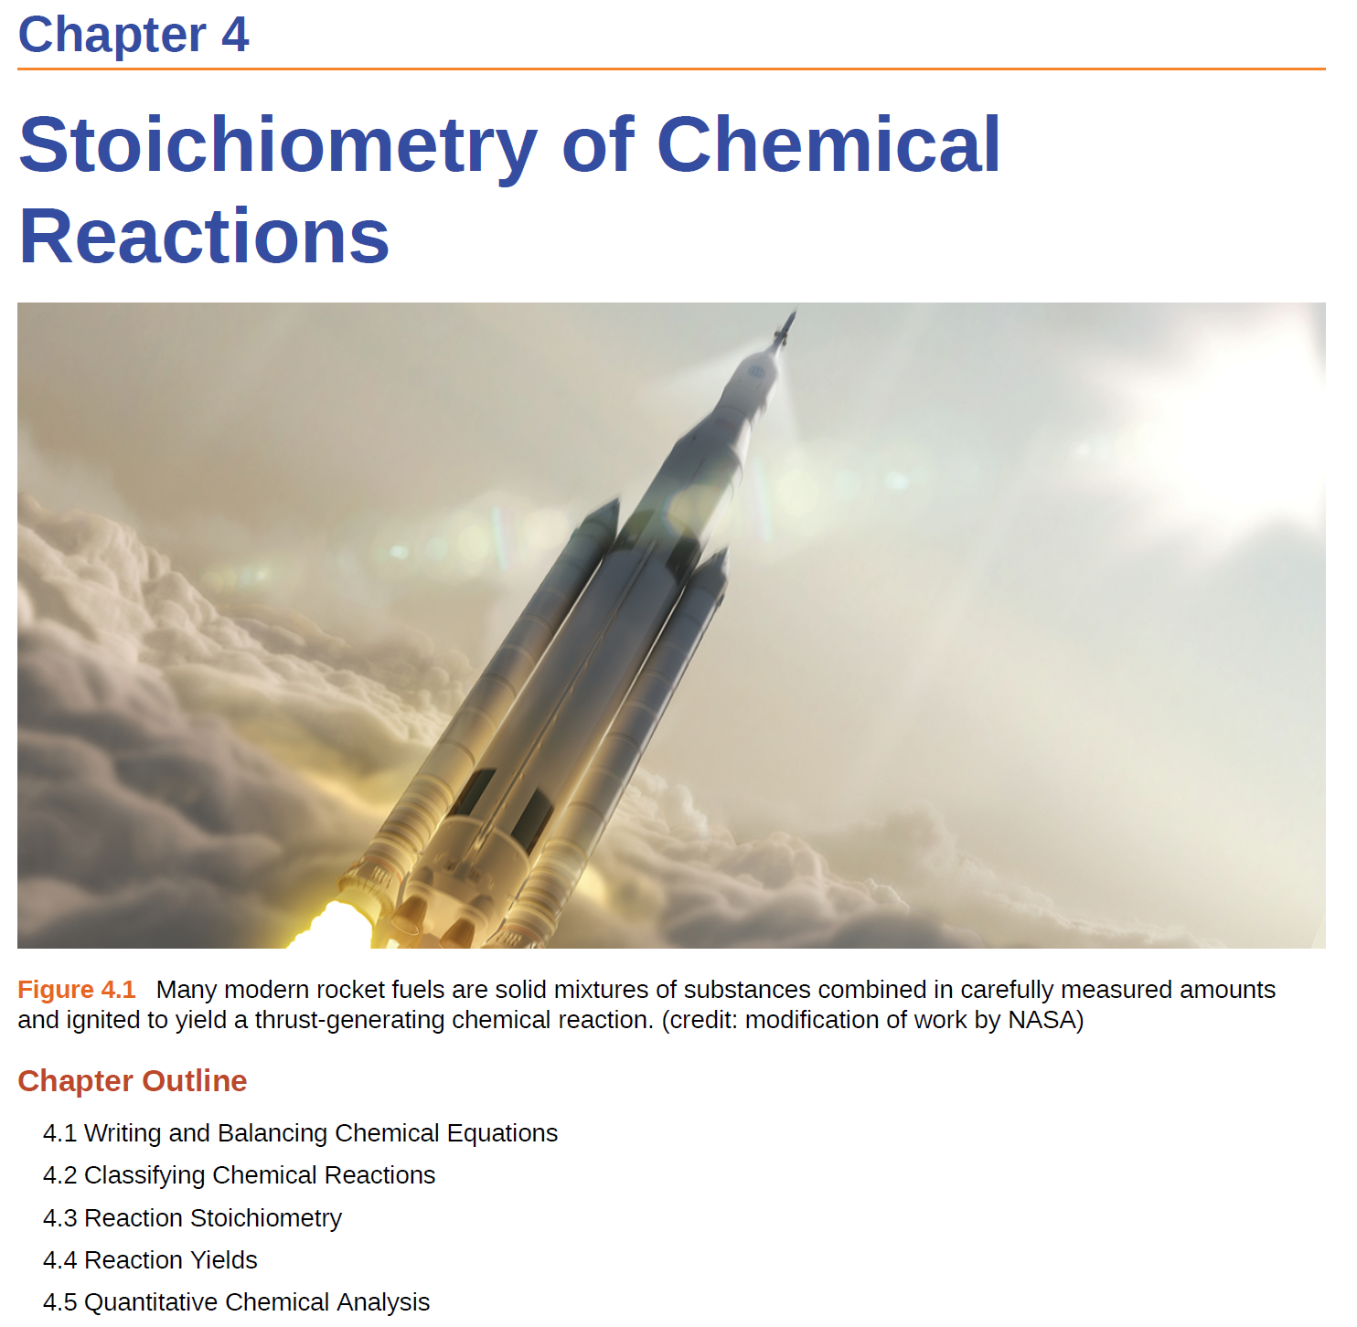
Precipitation (Ch 15)
Acid-base (Ch 14)
Oxidation reduction

Slide 4
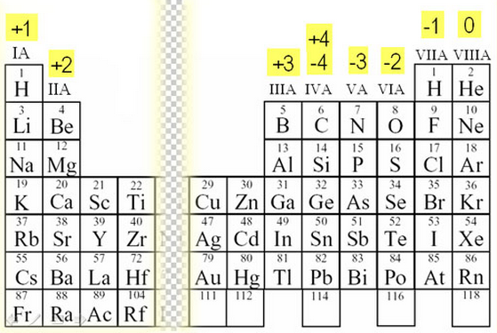
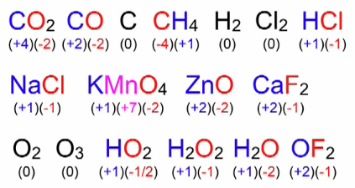
Oxidation Number (or Oxidation State)
Oxidation number is a positive or negative number assigned to an atom to indicate its degree of oxidation or reduction.
The oxidation number of a free element is 0.
The oxidation number of H is +1.
The oxidation number of O in compounds is usually -2.
Then the oxidation number of a Group 1 element in a compound is +1.
The oxidation number of a Group 2 …

Slide 5
Oxidation and reduction
Oxidation = loss of electron(s)
Zn(s) Zn²⁺(aq) + 2e⁻
Reduction = gain of electron(s)
Cu²⁺(aq) + 2e⁻ Cu(s)
Mnemonics
LEO the lion says GER
OIL RIG
LEO = Loss of Electrons is Oxidation
GER = Gain of Electrons is Reduction
OIL = Oxidation Is Loss (of Electrons)
RIG = Reduction Is Gain (of Electrons)

Slide 6
Oxidation, Reduction, and Oxidation Numbers
Oxidation:
Loss of electrons
Electrons are a product
The species is oxidized
Increases the oxidation number
Cu (s) → Cu²⁺ (aq) + 2 e⁻
Reduction:
Gain of electrons
Electrons are a reactant
The species is reduced
Decrease in the oxidation number
Zn²⁺(aq) + 2e⁻ → Zn(s)

Slide 7
Question:
Are the following reactions:
A) oxidation B) reduction C) neither
1) Sn(s) → Sn⁴⁺(aq) + 4e⁻
2) Fe³⁺(aq) + 1e⁻ → Fe²⁺(aq)
3) Cl₂(g) → Cl₂(l)
4) Cl₂(g) + 2e⁻ → 2Cl⁻(aq)
But…free electrons do not exist!
(except in special conditions)

Slide 8
Zn²⁺_{(aq)} + Cu_{(s)} → Cu²⁺_{(aq)} + Zn_{(s)}
Redox Reactions
Reduction-oxidation (REDOX) reaction: transfers electrons from one reactant to another.
Zn is reduced
Cu is oxidized
Cu (s) → Cu²⁺ (aq) + 2 e⁻
Zn²⁺(aq) + 2e⁻ → Zn(s)
oxidation
reduction

Slide 9
Zn²⁺_{(aq)} + Cu_{(s)} → Cu²⁺_{(aq)} + Zn_{(s)}
Redox Terminology
Zn is reduced
Cu is oxidized
oxidizing agent
oxidant
reducing agent
reductant
Reducing Agent (Reductant)
A species that gives up electrons.
It is oxidize during the process.
Oxidizing agent (oxidant)
A species that gains electrons.
It is reduced during the process.

Slide 10
2Ag⁺ + 2Br⁻ → 2Ag + Br₂
Question:
(A)
(B)
(C)
(D)
Which species is oxidized?
Which species is the oxidizing agent?
2Cu⁺ → Cu⁰ + Cu²⁺
(A)
(B)
(C)
Which species is reduced?
Which species is the reducing agent?

Slide 11
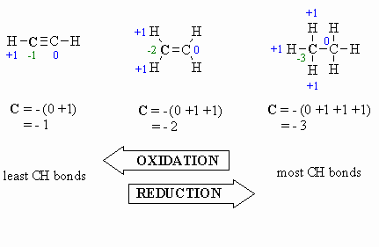
Side note: REDOX in Organic Chemistry
Losing electrons
Adding oxygen atoms
Losing hydrogen atoms
Oxidation
Adding electrons
Losing oxygen
Adding hydrogen
Reduction

Slide 12
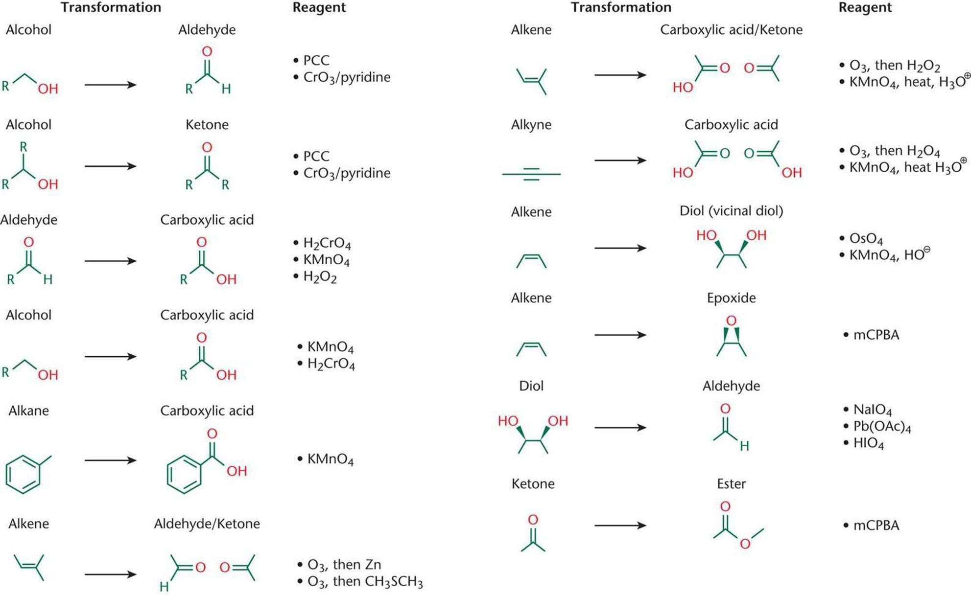
Side note: Oxidation Reactions

Slide 14
Steps For Balancing Redox Reactions
1. Write the two half-reactions representing the redox process.
2. Balance all elements except oxygen and hydrogen.
3. Balance oxygen atoms by adding H₂O molecules.
4. Balance hydrogen atoms by adding H⁺ ions.
5. Balance charge by adding electrons.
6. If necessary, multiply each half-reaction’s coefficients by the smallest possible integers to yield equal numbers of electrons in each.
7. Add the balanced half-reactions together and simplify by removing species that appear on both sides of the equation.
8. For reactions occurring in basic media (excess hydroxide ions), carry out these additional steps:
a. Add OH⁻ ions to both sides of the equation in numbers equal to the number of H⁺ ions.
b. On the side of the equation containing both H⁺ and OH⁻ ions, combine these ions to yield water molecules.
c. Simplify the equation by removing any redundant water molecules.
9. Finally, check to see that both the number of atoms and the total charges are balanced.

Slide 15
Steps For Balancing Redox Reactions
Balance the oxidation of Fe²⁺ to Fe³⁺ by Cr₂O₇²⁻ in acid solution
Write the unbalanced equation for the reaction in ionic form.
Fe²⁺ + Cr₂O₇²⁻ Fe³⁺ + Cr³⁺
Separate the equation into two half-reactions.
+2
+3
Oxidation:
Fe²⁺ Fe³⁺
+6
+3
Reduction:
Cr₂O₇²⁻ Cr³⁺
Balance the atoms other than O and H in each half-reaction.
Cr₂O₇²⁻ 2Cr³⁺

Slide 16
Balancing Redox Equations
For reactions in acid, add H₂O to balance O atoms and H⁺ to balance H atoms.
Cr₂O₇²⁻ 2Cr³⁺ + 7H₂O
14H⁺ + Cr₂O₇²⁻ 2Cr³⁺ + 7H₂O
Add electrons to one side of each half-reaction to balance the charges on the half-reaction.
Fe²⁺ Fe³⁺ + 1e⁻
6e⁻ + 14H⁺ + Cr₂O₇²⁻ 2Cr³⁺ + 7H₂O
If necessary, equalize the number of electrons in the two half-reactions by multiplying the half-reactions by appropriate coefficients.
6Fe²⁺ 6Fe³⁺ + 6e⁻
6e⁻ + 14H⁺ + Cr₂O₇²⁻ 2Cr³⁺ + 7H₂O

Slide 17
Balancing Redox Equations
Add the two half-reactions together and balance the final equation by inspection. The number of electrons on both sides must cancel.
Oxidation:
6Fe²⁺ 6Fe³⁺ + 6e⁻
Reduction:
6e⁻ + 14H⁺ + Cr₂O₇²⁻ 2Cr³⁺ + 7H₂O
14H⁺ + Cr₂O₇²⁻ + 6Fe²⁺ 6Fe³⁺ + 2Cr³⁺ + 7H₂O
Verify that the number of atoms and the charges are balanced.
14x1 – 2 + 6x2 = 24 = 6x3 + 2x3
For reactions in basic solutions, add OH⁻ to both sides of the equation for every H⁺ that appears in the final equation.

Slide 18
Steps For Balancing Redox Reactions
1. Write the two half-reactions representing the redox process.
2. Balance all elements except oxygen and hydrogen.
3. Balance oxygen atoms by adding H₂O molecules.
4. Balance hydrogen atoms by adding H⁺ ions.
5. Balance charge by adding electrons.
6. If necessary, multiply each half-reaction’s coefficients by the smallest possible integers to yield equal numbers of electrons in each.
7. Add the balanced half-reactions together and simplify by removing species that appear on both sides of the equation.
8. For reactions occurring in basic media (excess hydroxide ions), carry out these additional steps:
a. Add OH⁻ ions to both sides of the equation in numbers equal to the number of H⁺ ions.
b. On the side of the equation containing both H⁺ and OH⁻ ions, combine these ions to yield water molecules.
c. Simplify the equation by removing any redundant water molecules.
9. Finally, check to see that both the number of atoms and the total charges are balanced.
This is important!
But…
It’s a relic of the 1800s
Maybe the most boring aspect of echem.
Modern electrochemist do not do this.

Slide 19
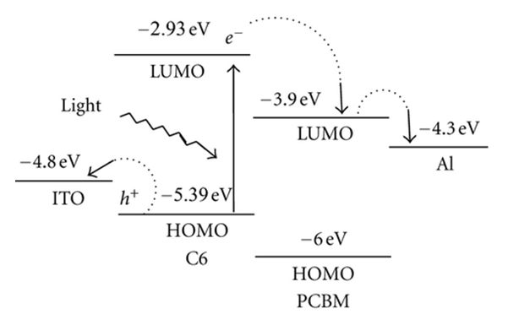
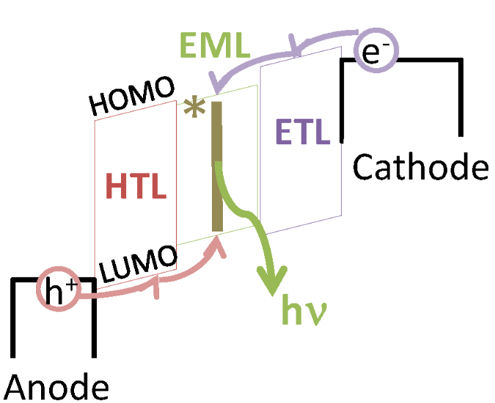
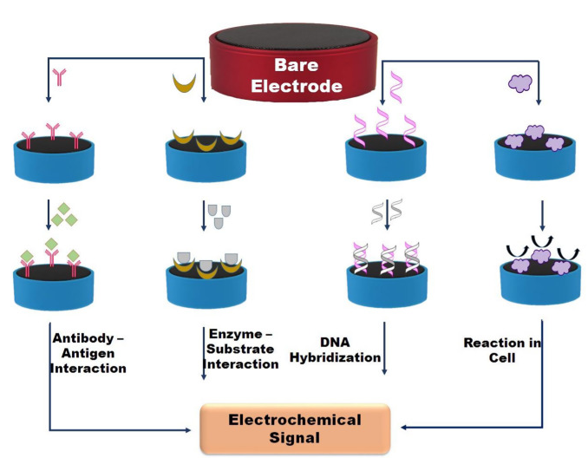
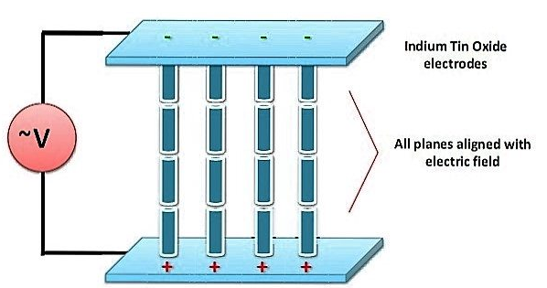
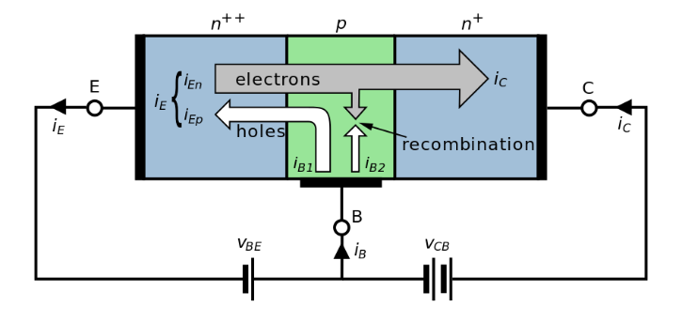
Modern Electrochemistry
Solar Cells
LEDs
LCDs
Biosensors
Transistors
Basically, anything that generates or runs on electricity!

Slide 20
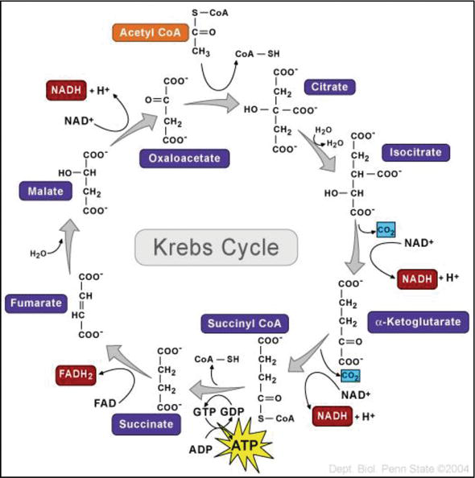
Modern Bioelectrochemistry

Slide 21
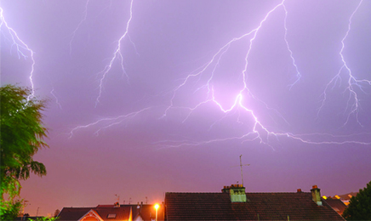
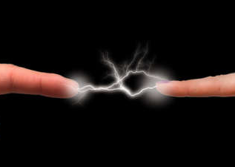
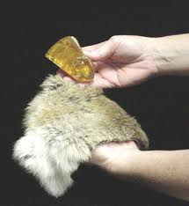
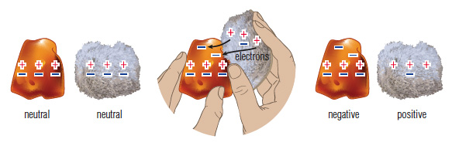
But First…Some History
Thales of Miletos (600 BC)

Slide 22
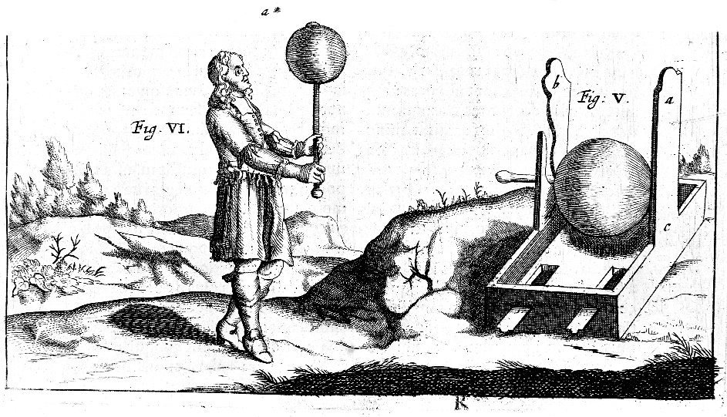
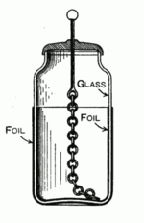
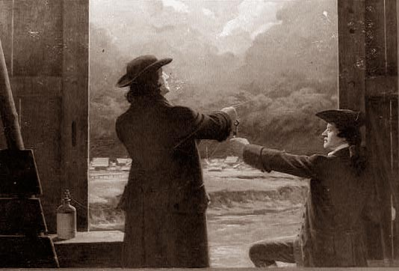
More History
Otto von Guericke (1663)
Lyden Jar (1745)
Ben Franklin (1740)

Slide 23
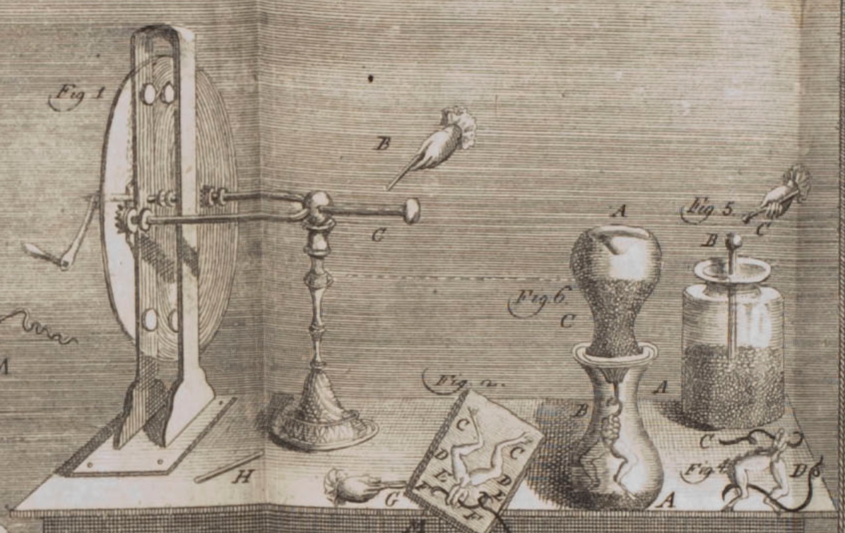
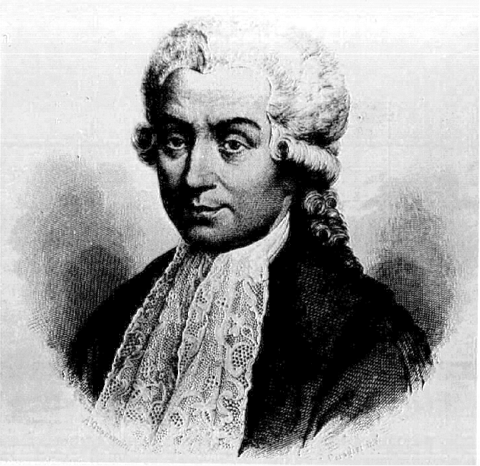
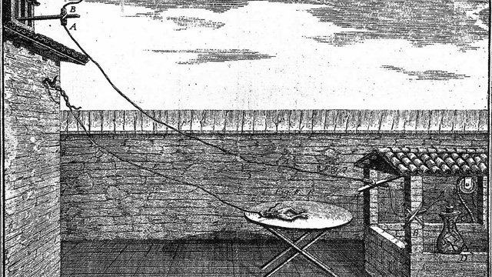
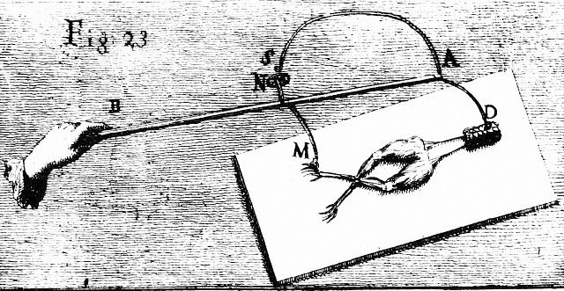
More History
Luigi Galvani (1770)
Surgeon and Anatomist
Also studied static electricity
Galvani concluded that the metals helped release the “animal electricity” in nerves.
Mixed metal wire = stronger contractions

Slide 24
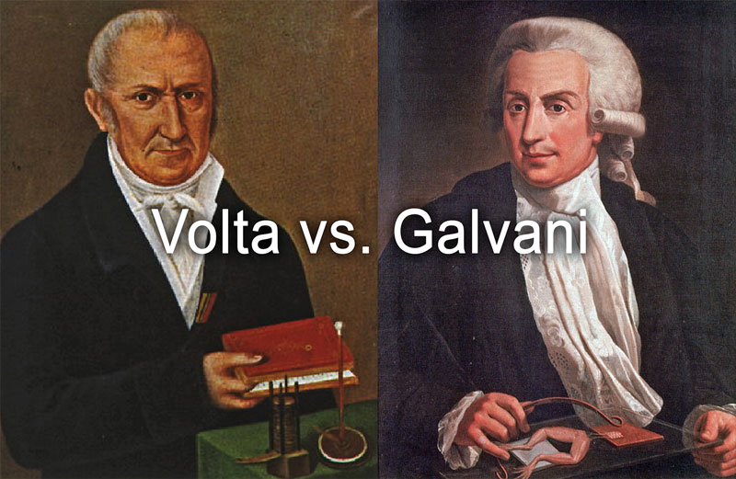
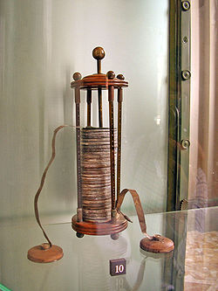
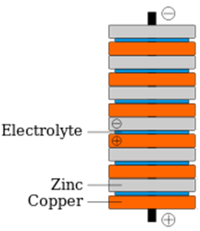
Alessandro Volta 1774
Luigi Galvani
1770
I don’t believe you.
It’s the metals.
Electricity is generate by the animal.
So he invented the battery!
AKA: Voltaic Pile

Slide 25
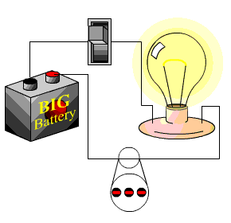
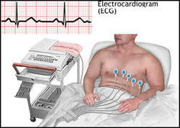
Alessandro Volta 1774
Luigi Galvani
1770
Namesake for the SI unit of Volt.
Namesake for the Galvanic Cell
Volta coined the term "Galvanism" for a direct current of electricity produced by chemical action, and not from animals.
Turns out they were both partially right.

Slide 26
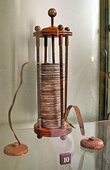
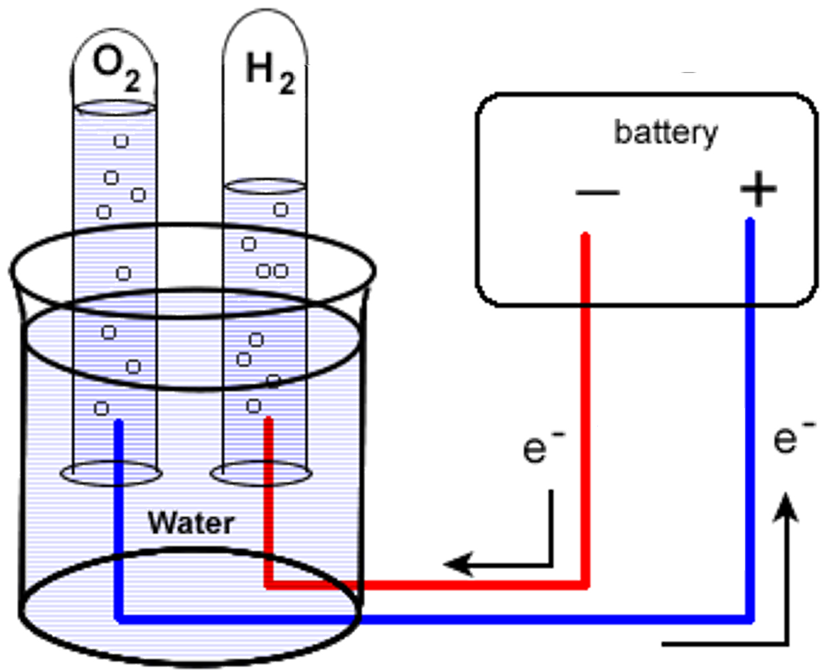
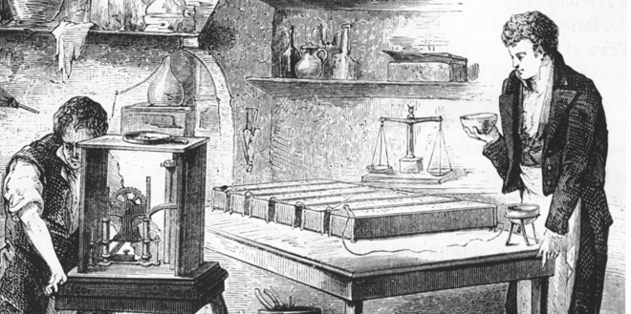
Humans Harness Electricity
Water Electrolysis
Electro-decomposition
1800
1807-1808
Isolation of sodium, potassium, barium, calcium, boron, strontium, and magnesium.
1774
William Nicholson and Anthony Carlisle
Humphry Davy

Slide 27
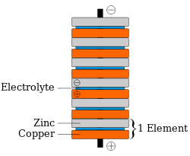
Galvanism
Why does this give us electricity?

Slide 29
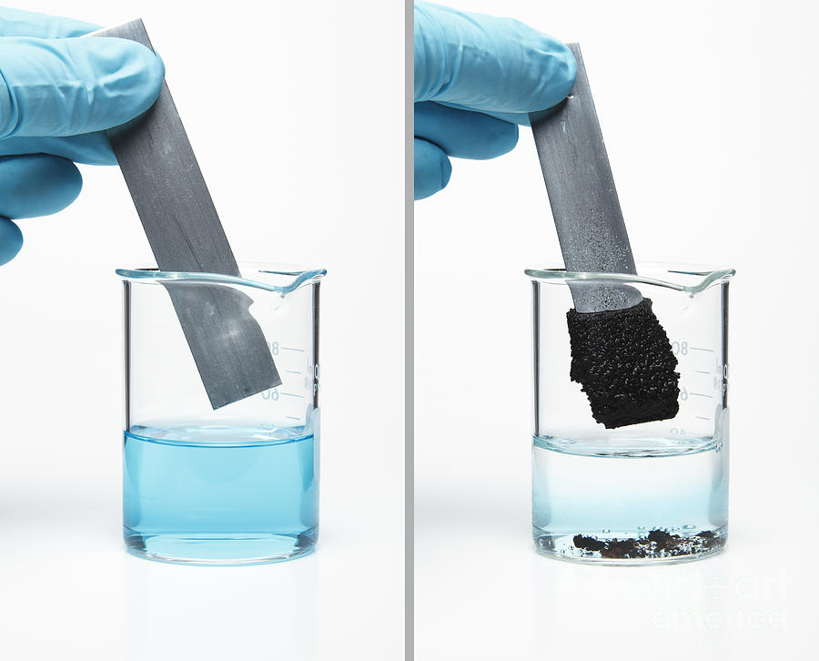
Mixed Metal Systems
Zn(s)
Cu(s)
Cu²⁺
Zn²⁺

Slide 30
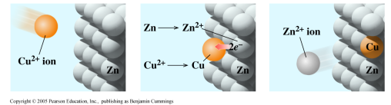
Mixed Metal Systems
Zn(s) → Zn²⁺(aq) + 2e⁻
Zn(s)
Cu²⁺(aq) + 2e⁻ → Cu(s)
Cu²⁺(aq) + Zn(s) → Cu(s) + Zn²⁺(aq)
Cu(s)
Cu²⁺
is reduced
Cu²⁺
Zn²⁺
Zn
is oxidized
Electrons are “flowing” from Zn to Cu²⁺!

Slide 31
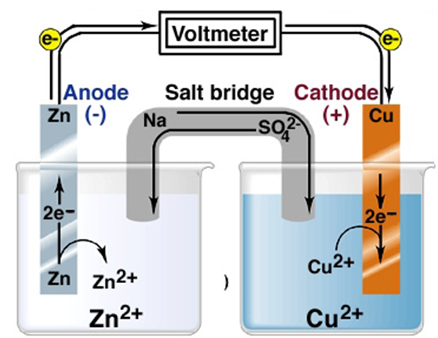
Galvanic Cell
e⁻
Cathode
Reduction
reaction
Anode
Oxidation
reaction
Salt Bridge-transports cations and anions to balance charge and completes the circuit.

Slide 32
Galvanic Cell Summary
“Compartmentalizing” the oxidation and reduction half reactions into half-cells, enables a redox reaction to be a source of electrical energy.
In one half-cell, the anode, oxidation occurs.
In the other half-cell, the cathode, reduction occurs.
The electrodes are joined by a wire (external circuit).
The salt bridge is a porous material consisting of a concentrated salt solution.
NaNO₃ or KNO₃ are frequently used.
Anions flow toward the anode to neutralize the build-up of positive charge.
Cations flow toward the cathode to “replace” the cations that are being consumed.

Slide 33
Cell Notation
Current
Zn(s) → Zn²⁺(aq) + 2e⁻
Cu²⁺(aq) + 2e⁻ → Cu(s)
Zn(s) | Zn²⁺ || Cu²⁺ | Cu(s)
anode
cathode

Slide 34
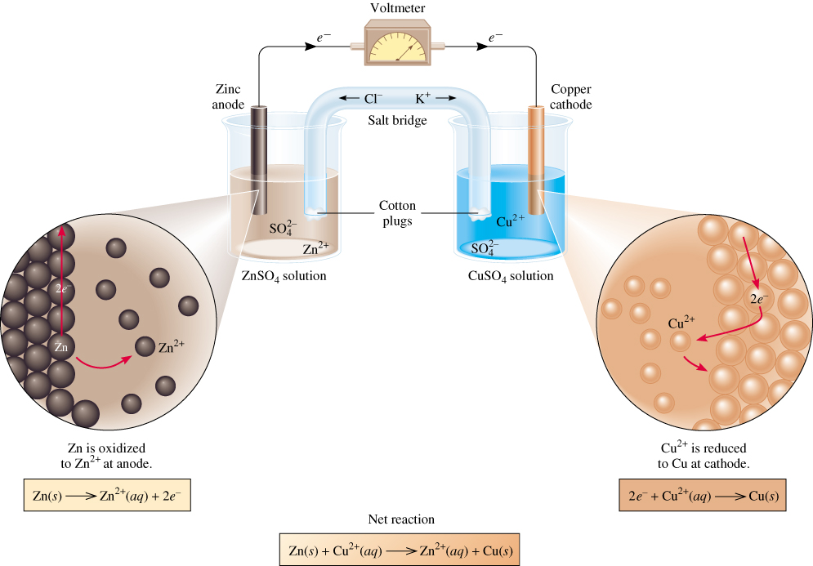
Galvanic Cell
Zn(s) | Zn²⁺ || Cu²⁺ | Cu(s)
Voltmeter = +1.10 V

Slide 35
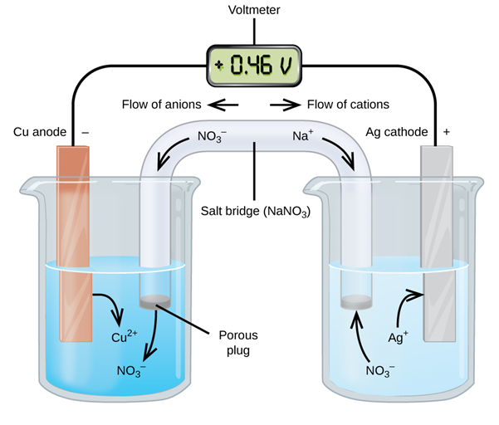
Galvanic Cell
Potential depends on the REDOX reactions.
Cu(s) | Cu²⁺ || Ag²⁺ | Ag(s)
Voltmeter = +0.46 V

Slide 36


Slide 37

Cell Potential
Cell potential (E_{cell})-measure of the energy per unit charge available from the REDOX reaction.
Dictated by the oxidation and reduction reactions.
oxidation
D(s) → D²⁺(aq) + 2e⁻
Anode
reduction
A²⁺(aq) + 2e⁻ → A(s)
Cathode
E_{cell} = E_{cathode} − E_{anode}
There is no absolute energy scale!

Slide 38
Standard Potential (E°)
The driving force (E) of an electrochemical reaction/cell is dictated by the half reactions.
Depends on the nature of the oxidant/reductant and the concentration of species involved.
To compare apples to apples we define
Standard potentials (E°):
All aqueous concentrations at 1M
The pressure of all gases at 1 atm
Temp. held constant (usually at 25 °C)
SI unit of E° is volts (V or mV)
Since this can be measured
E°_{cell} = E°_{cathode} − E°_{anode}
Relative values can be found

Slide 39
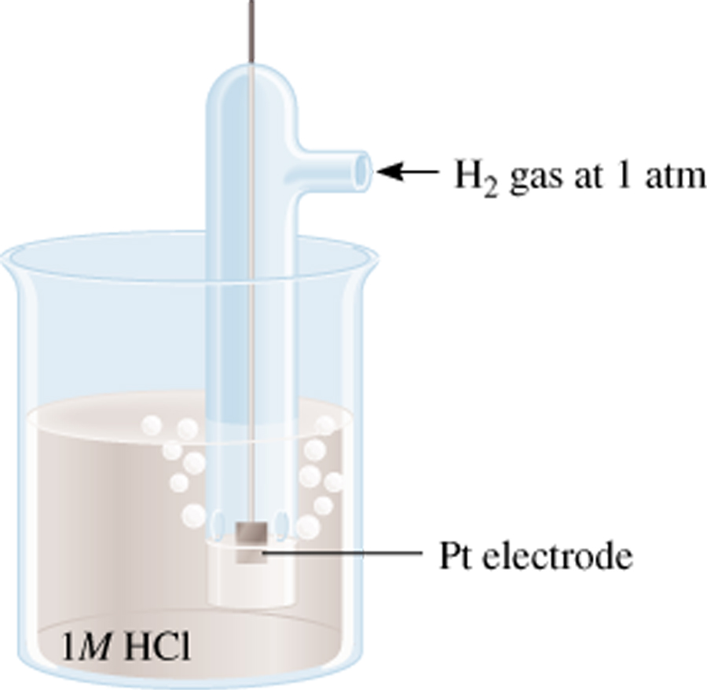
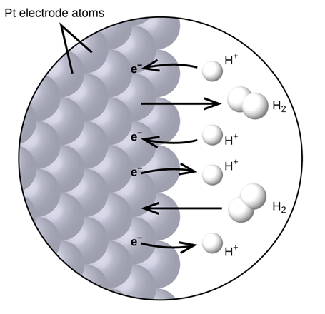
Setting 0
The electrochemical community has agreed that the reduction of 2H⁺ ions to H₂(g) has been assigned to be 0.000 V. This is called the standard hydrogen electrode (SHE).
2e⁻ + 2H⁺ (1 M) 2H₂ (1 atm)
Eº = 0 V
Standard hydrogen electrode
(SHE)

Slide 40
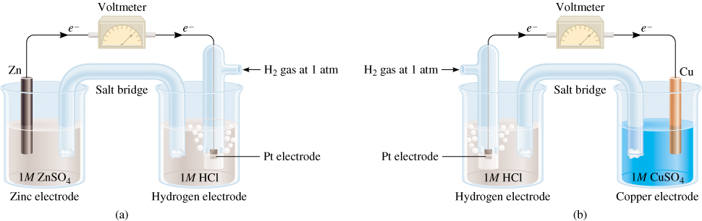
Determining Standard Potentials (Zn)
0.76 V
o
Anode (oxidation):
Zn (s) Zn²⁺ + 2e⁻
E_{Zn /Zn} = -0.76 V
2+
o
Cathode (reduction):
2e⁻ + 2H⁺ 2H₂
E_{H /H} = 0V
+
2
Eº = E_{H /H} - E_{Zn /Zn}
Measured
0.76 V
o
o
cell
2+
2
Set to 0
Calculate

Slide 41
Determining Standard Potentials (Cu)
0.34 V
E⁰ = E_{cathode} - E_{anode}
0
0
cell
E_{cell} = E_{Cu /Cu} – E_{H /H}
0
0
2+
0
+
2
0.34 = E_{Cu /Cu} - 0
0
2+
0
E_{Cu /Cu} = 0.34 V
2+
Anode (oxidation):
H₂ (1 atm) 2H⁺ (1 M) + 2e⁻
Cathode (reduction):
2e⁻ + Cu²⁺ (1 M) Cu (s)
Repeat for other oxidation/reduction reactions.

Slide 42
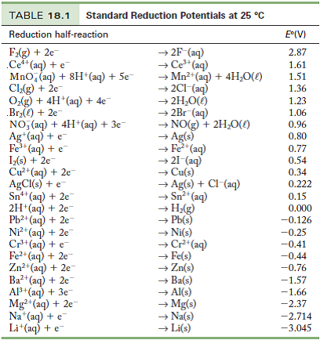
Standard Potential (E°)
Better oxidizing agent
(+)
More easily reduced
Direction of Electron transfer
Eº_{(H2)} = 0 V
Better reducing agent
(-)
More easily oxidized

Slide 43
Standard Potential (E°)
Combine any two and you can calculate the cell potential (E°_{cell}).
1) More positive is the reduced (cathode), more negative is oxidized (anode).
2) Find the potential for each reduction half reaction.
3) Calculate the E°_{cell}.
Note: Changing the stoichiometric coefficients of a half-cell reaction does not change the value of Eº
E°_{cell} = E°_{cathode} − E°_{anode}

Slide 44
Standard Potential (E°)
Zn(s) | Zn²⁺ || Cu²⁺ | Cu(s)
Cu²⁺(aq) + 2e⁻ → Cu(s)
0.34 V
Zn²⁺(aq) + 2e⁻ → Zn(s)
-0.76 V
Accounts for the reaction flip
E°_{cell} = E°_{cathode} − E°_{anode}
E°_{cell} = (0.34) − (-0.76) = 1.1 V

Slide 45
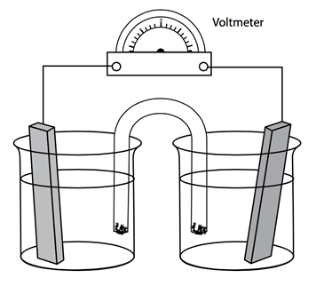
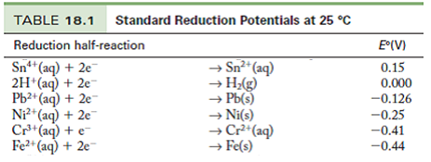
Questions:
e⁻
e⁻
Pb(s)
cathode
anode
Fe(s)
Pb
Pb²⁺
Fe²⁺
Fe
1) Which metal will reduced and oxidized?
More positive = reduced (cathode)
More negative = oxidized (anode).
2) Which direction are the electrons going?
From Fe(s) to Pb²⁺

Slide 46
Questions:
e⁻
e⁻
Pb(s)
cathode
anode
Fe(s)
Pb
Pb²⁺
Fe²⁺
Fe
3) What are the half reactions?
Pb²⁺(aq) + 2e⁻ → Pb(s)
Zn(s) → Zn²⁺(aq) + 2e⁻
4) What is the overall reaction?
Pb²⁺(aq) + Zn(s) → Pb(s) + Zn²⁺(aq)
5) What is the cell notation?
Fe(s) | Fe²⁺ || Pb²⁺ | Pb(s)
anode
cathode

Slide 47
Questions:
e⁻
e⁻
Pb(s)
cathode
anode
Fe(s)
Pb
Pb²⁺
Fe²⁺
Fe
6) What is the cell potential?
Pb²⁺(aq) + 2e⁻ → Pb(s)
-0.126 V
Zn²⁺(aq) + 2e⁻ → Zn(s)
-0.440 V
E°_{cell} = E°_{cathode} − E°_{anode}
E°_{cell} = (-0.126) − (-0.44)
E°_{cell} = 0.31 V

Slide 48
Questions:
Better oxidizing agent
Better reducing agent
1) If you wanted to design a high voltage battery which reducing agent would you choose for the anode?
Li⁺(aq) + e⁻ → Li(s)

Slide 49
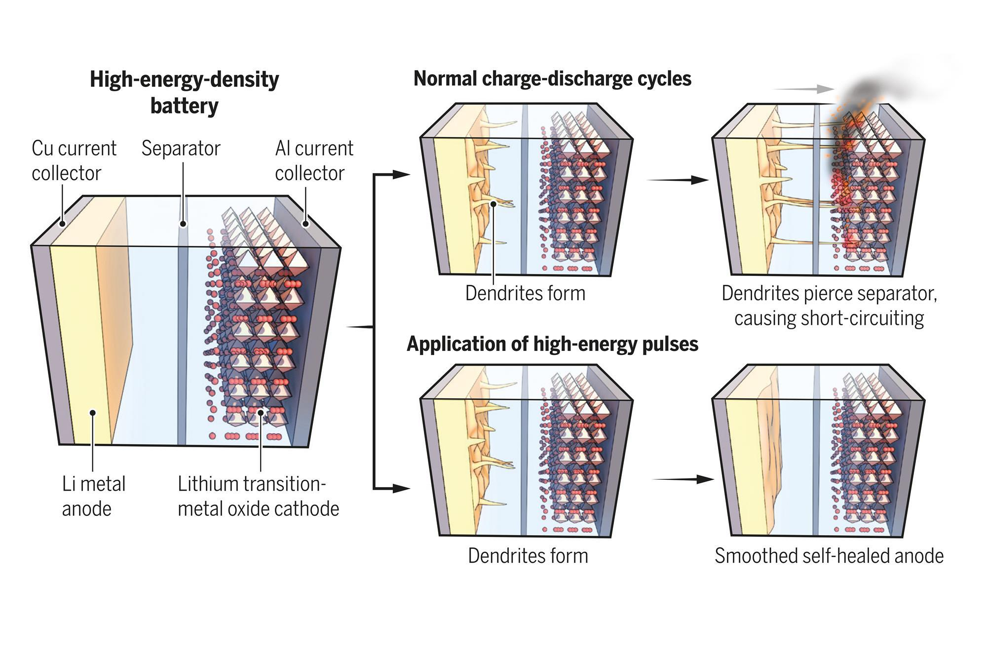
Questions:
Better oxidizing agent
Better reducing agent
1) If you wanted to design a high voltage battery which reducing agent would you choose for the anode?
Li⁺(aq) + e⁻ → Li(s)

Slide 51
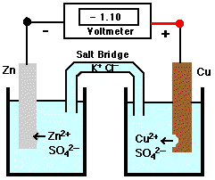
Electrochemistry and Energy
Zn(s) | Zn²⁺ || Cu²⁺ | Cu(s)
Cu(s) | Cu²⁺ || Zn²⁺ | Zn (s)
oxidation
reduction
oxidation
reduction
E°_{cell} = +1.10 V
E°_{cell} = -1.10 V
current flows
chemical energy into electrical energy
current does not flow
Positive E°_{cell} = Spontaneous
Negative E°_{cell} = non-spontaneous
E°_{cell} is a thermodynamic parameter!

Slide 52
E° and ΔG°
° indicates standard conditions (gases at 1 atm (or 1 bar); aqueous specices at 1 M)
ΔG° is the Gibbs free energy
E°_{cell} is the standard cell potential
n is the number of moles of electrons transferred in the balanced redox reaction.
F is called the Faraday constant, this is the charge of a mole of electrons. F = 9.648 x 10⁴ J/mol . V
Note that ΔG° and E° have opposite signs.

Slide 53
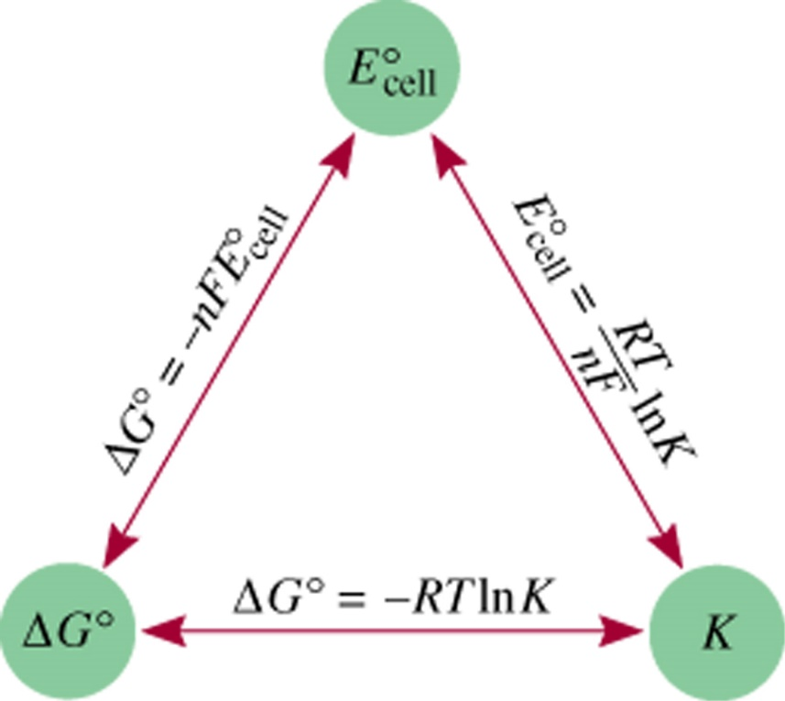
ΔG, Eº, and K
ΔGº = -nFE_{cell}
ΔGº = -RT ln K
o
o
-nFE_{cell}
= -RT ln K
RT
o
=
ln K
E_{cell}
nF
If you know one, you can calculate the other two…
If you know K, you can calculate ΔEº and ΔGº
If you know ΔEº, you can calculate ΔGº and K
etc.

Slide 54
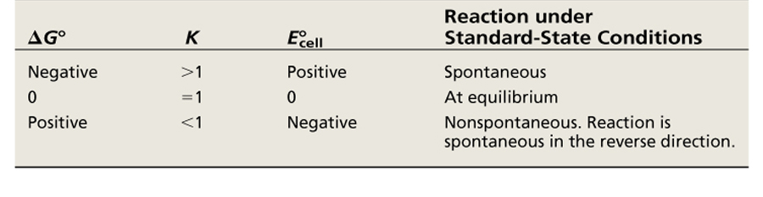
ΔG, Eº, and K

Slide 55
The Nernst Equation
RT
o
=
ln K
E_{cell}
nF
These experiments are usually done at 25 °C (298 K)
(8.314 J/K•mol)(298 K)
o
=
E_{cell}
ln K
n (96,500 J/V•mol)
0.0257 V
o
ln K
E_{cell}
=
n
0.0592 V
o
log K
E_{cell}
=
n

Slide 56
Non-standard Conditions
To this point, we have dealt only with “standard” potentials (E°), when aqueous species are at 1 M.
At equilibrium:
ΔG° = -R T ln K
ΔG = ΔG° + R T ln Q
At any time:
[P]
Q
=
[R]
Concentration matters!

Slide 57
Concentration Cell
Zn²⁺(aq) + 2e⁻ → Zn(s)
0.76 V
Zn(s)
anode
cathode
Zn(s)
E°_{cell} = E°_{cathode} − E°_{anode}
E°_{cell} = 0.76 − 0.76
Zn²⁺
Zn²⁺
Zn
Zn
E°_{cell} = 0 V
1 M
1 M
Zn(s) | Zn²⁺(1 M) || Zn²⁺ (1 M) | Zn(s)
anode
cathode
Standard Conditions!
[1]
lnQ
= ln
= 0
[1]
E_{cell} = E°_{cell} = 0 V

Slide 58
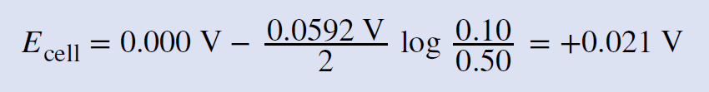
Concentration Cell
Zn²⁺(aq) + 2e⁻ → Zn(s)
0.76 V
Zn(s)
anode
cathode
Zn(s)
E°_{cell} = E°_{cathode} − E°_{anode}
E°_{cell} = 0.76 − 0.76
Zn²⁺
Zn²⁺
Zn
Zn
E°_{cell} = 0 V
0.1 M
0.5 M
Zn(s) | Zn²⁺(0.1 M) || Zn²⁺ (0.5 M) | Zn(s)
anode
cathode
Non-standard Conditions!
[0.1]
lnQ
= ln
≠ 0
[0.5]
There is a cell potential!

Slide 59
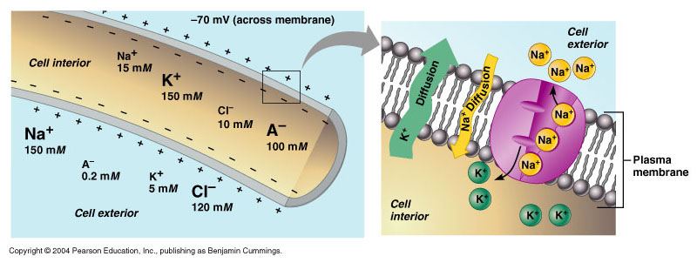
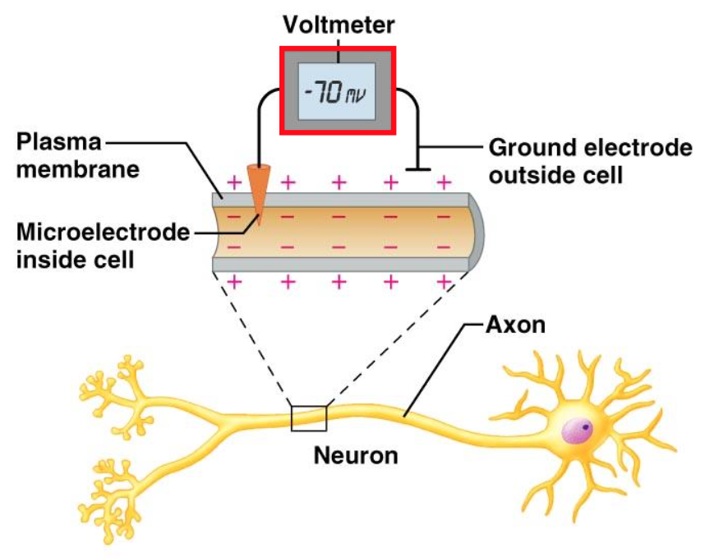
Biological Concentration Cell

